Slide 1
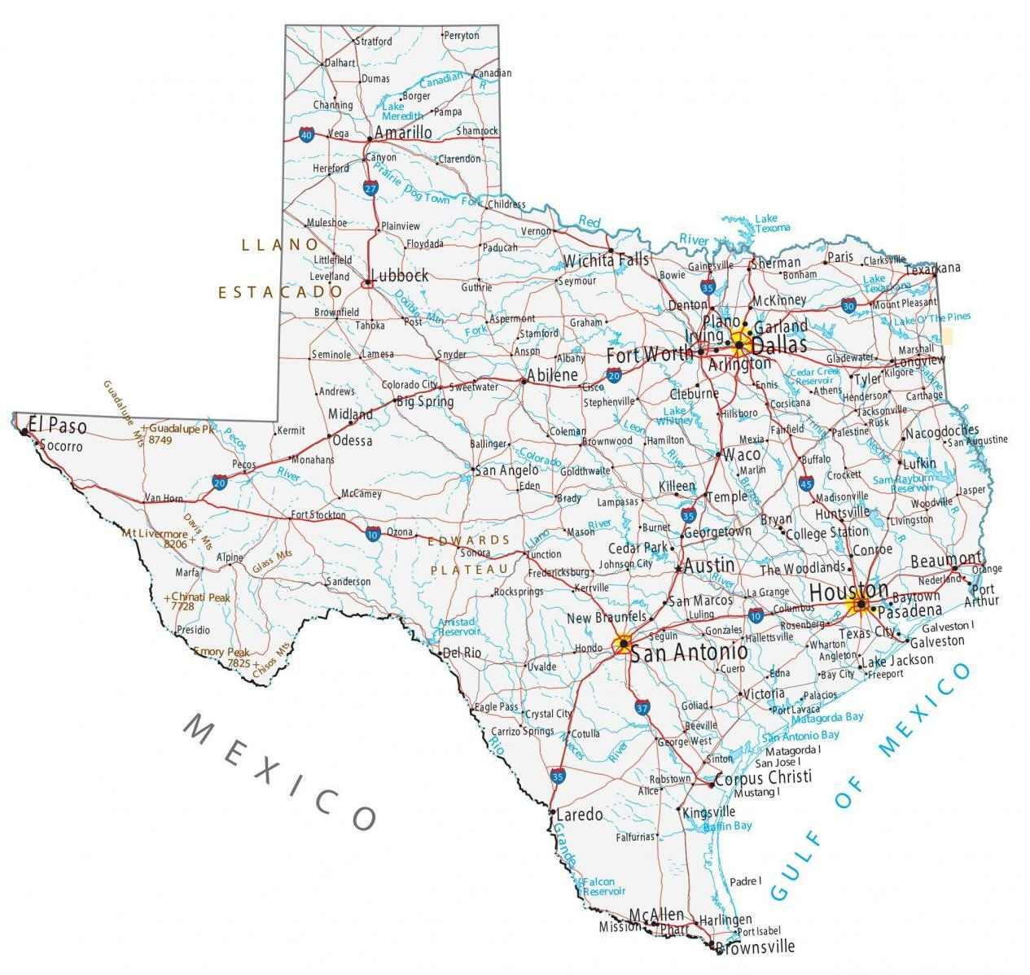

TEXAS SOUTH CENTRAL PIPELINES
Arcgis & pgsql AnaLYSIS
Ademola Ibironke, Michael Burgos, Barbara Pablo, and Prudhvi Raj Dasari

Slide 2
Team Responsibilities
Names | Contributions
ADEMOLA IBIRONKe | Creating shapefiles, pipeline analysis in ArcGIS and PgSQL, creating tables in PgSQL,creating polygon on ArcMap, and conducting the report.
MICHAEL BURGOS | Creating shapefiles, pipeline analysis in ArcGIS and PgSQL, creating tables in PgSQL, creating polygon on ArcMap, and conducting the report.
BARBARA PABLO | Gathering information, downloads, codes, tables from ArcGIS & PgSQL to the presentation and conducting the report.
PRUDHVI RAJ DASARI | Presented step 3 slide

Slide 3
Problem/Solutions
Problem
The county of Jefferson, Orange, Chambers, and Galveston pipelines extends from dry land to offshore. Our goal is to separate both areas into sections to analyze data.
Solutions
PostgreSQL (PgSQL) is a database management system emphasizing extensibility and SQL compliance. ArcGIS is a geospatial software to view, edit, manage, and analyze geographic data. Using both PgSQL and ArcGIS we can manage to separate sections and find data for each area : the total lengths, commodities, operation companies, etc .
Outline Steps
Importing the shapefiles to PgSQL as tables in the database. Identifying how many types of pipelines and operation companies in these 4 counties. Finding the length of each segment of pipeline in the attribute table. Summarize each county's commodity under each operation company and total length of the pipelines. Identifying the total length of pipelines under each operation company located offshore.

Slide 4

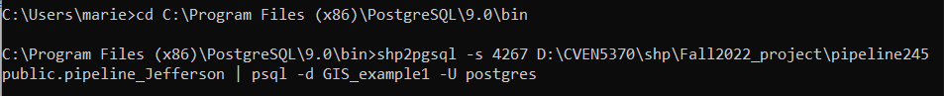
STEP 1
To get the shapefiles of pipelines by county we had to go to the website https://mft.rrc.texas.gov/link/d4eda8c4-9ff0-43b7-8f19-da0a57f10fd2
The counties we will be working with are: Jeffrson [245], Orange [361], Chambers [071], and Galveston [167].
We would need to create a new database in the pgAdmin III software (pgSQL)
After the downloads we will proceed to the database restoration using the command prompt.
Importing the shapefiles to PgSQL as tables in the database.

Slide 5
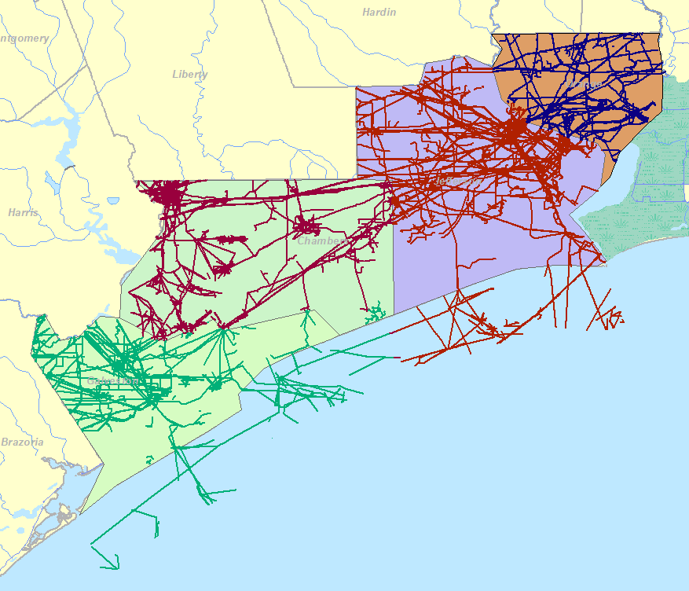
Cont. Step 1

Slide 6
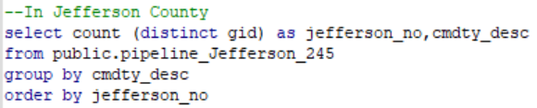
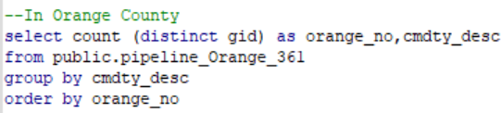
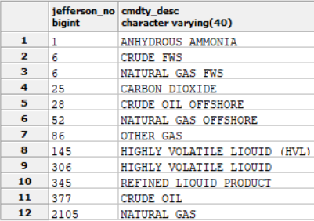
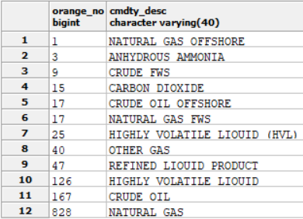
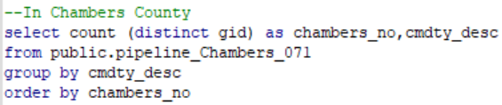
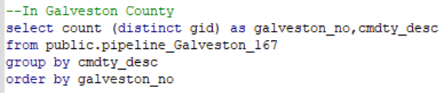
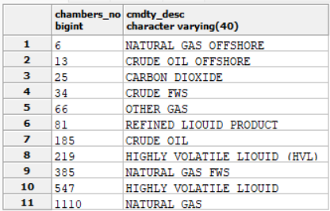
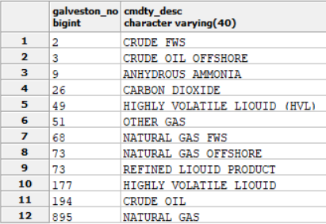
STEP 2
Identifying how many types of pipelines in these 4 counties.

Slide 7
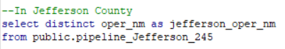
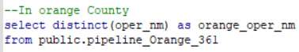
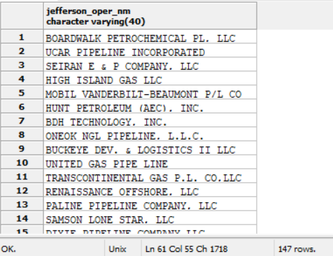
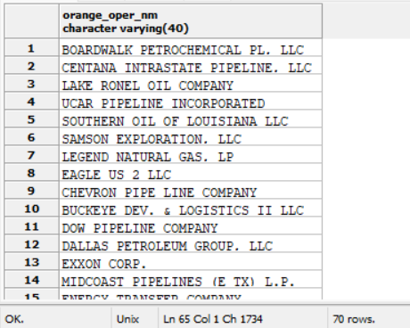
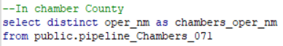
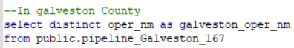
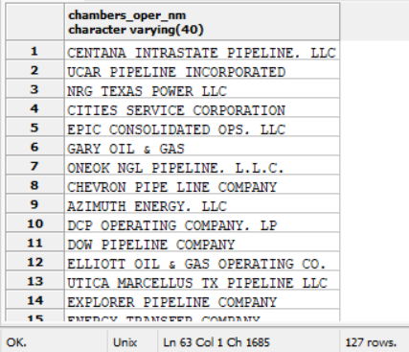
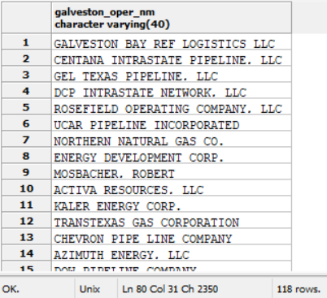
STEP 2
Identifying how many operation companies in these 4 counties.

Slide 8
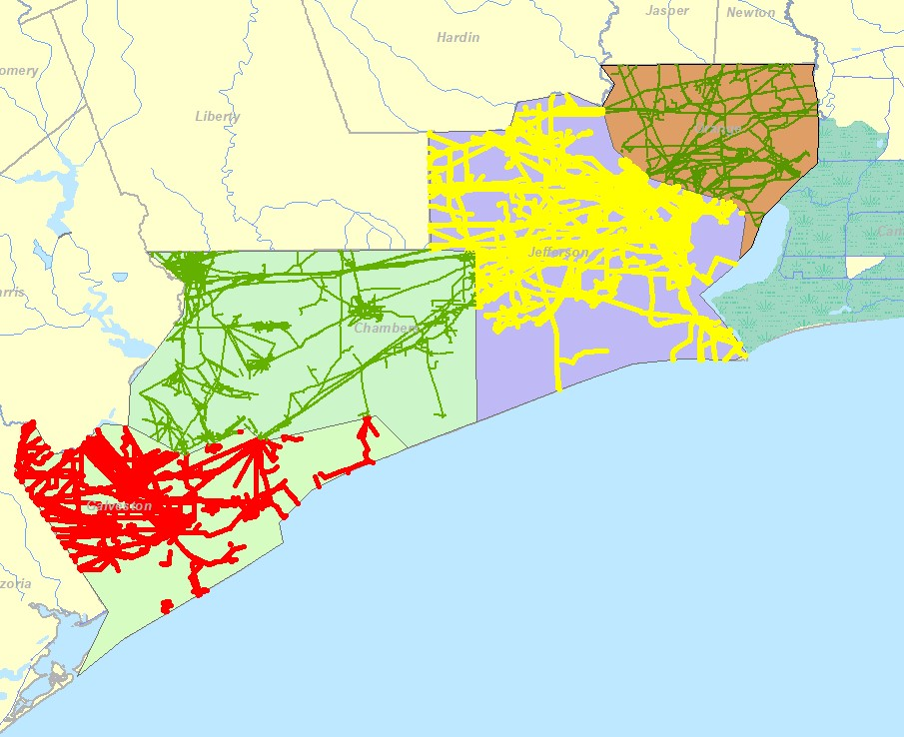
Cont. Step 2

Slide 9
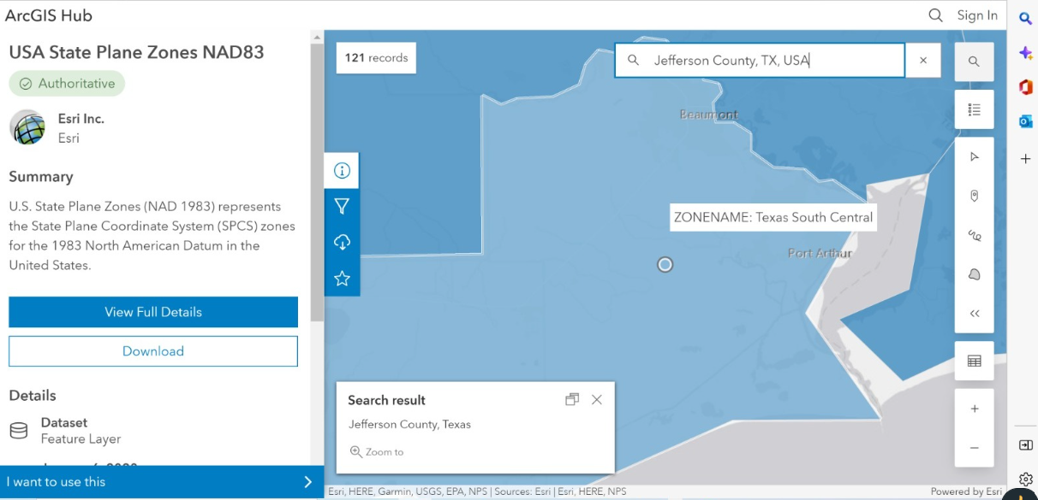
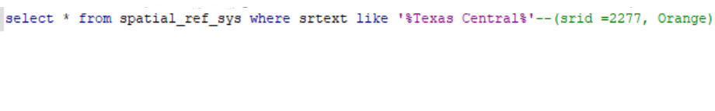
STEP 3
Obtain SRID
Transform the global coordinate system to local coordinate system
Determine length of each pipe from the geometry data
Update length for each segment of pipeline in the attribute table
Finding the length of each segment of pipeline in the attribute table.

Slide 10
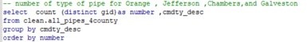
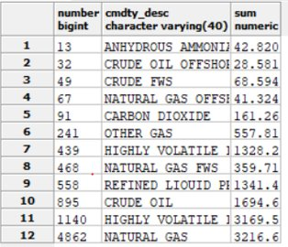
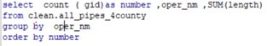
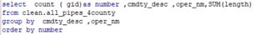
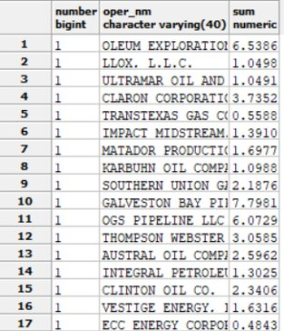
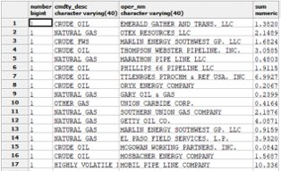
STEP 4
Summarize each county, for each type and under each operation company, fnding the total length of the pipelines.

Slide 11
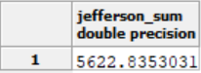
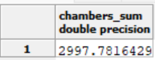
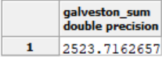
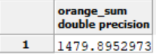
STEP 4
Summarize each county, for each type and under each operation company, finding the total length of the pipelines.

Slide 12
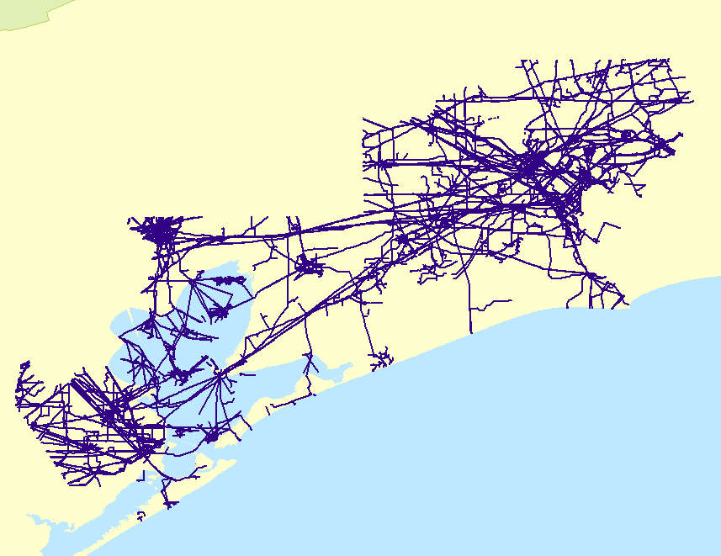
STEP 4
Summarize each county, for each type and under each operation company, finding the total length of the pipelines.

Slide 13
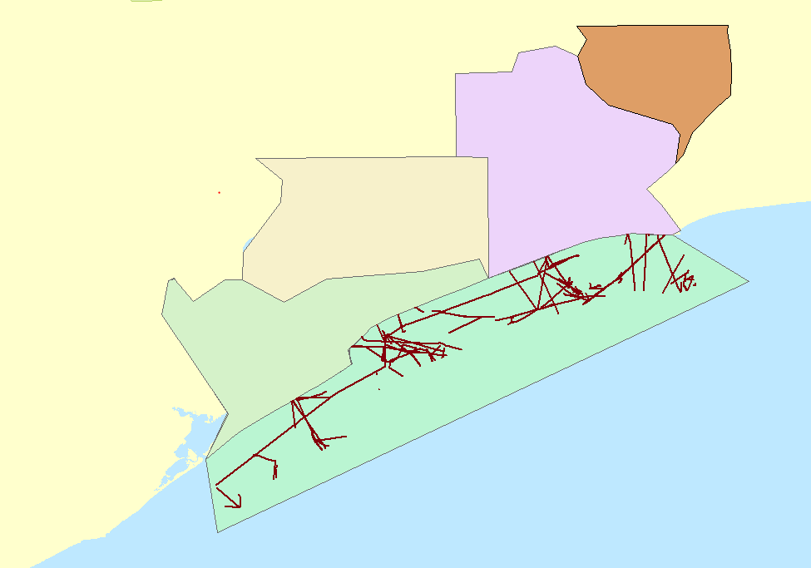
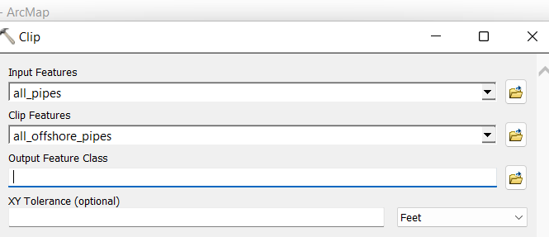
STEP 5
Draw polygons in ArcGIS to capture the offshore areas containing pipelines
Create shapefiles for the offshore pipelines polygons using Clip in ArcGIS
Identifying the total length of pipelines under each operation company (for each type) located offshore (in the Gulf of Mexico)
Notes:
A,b,c, codes, and last code, pic of polygon

Slide 14
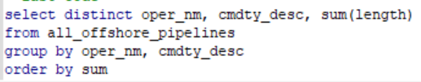
STEP 5
Transfer the shapefiles to tables in PgSQL using code below:
Merge all 4 offshore pipelines in ArcGIS and create the shapefile. Then transfer the created shapefile from ArcGIS to PgSQL in form of table "all_offshore_pipelines"
Update the new table in PgSQL with length of the pipes
Last Code
Identifying the total length of pipelines under each operation company (for each type) located offshore (in the Gulf of Mexico

Slide 15
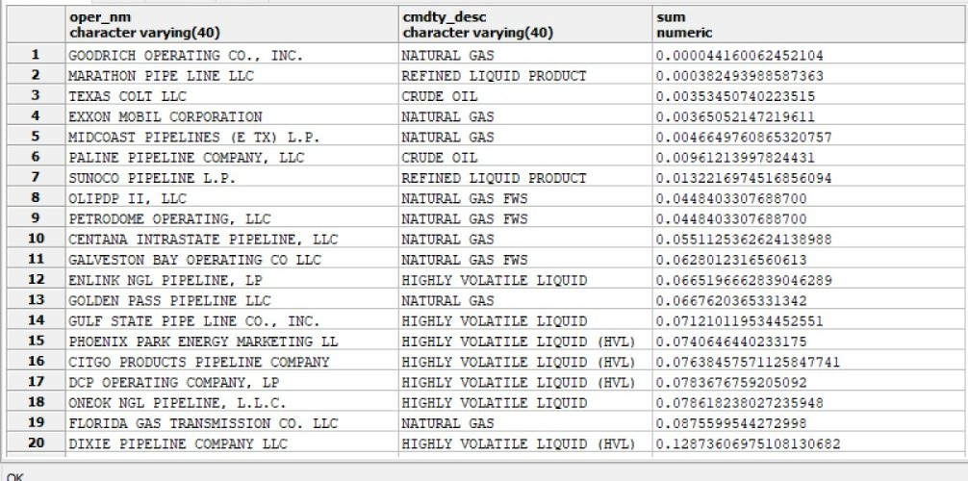
Cont. 5

Slide 16
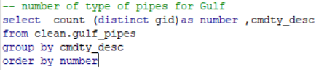
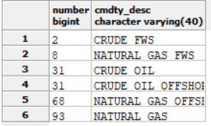
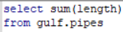
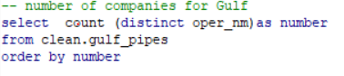
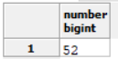
Info about the pipes in the Gulf
 | sum
1 | 617
Number of type of pipes, operation companies, and total length of the pipelines.

Slide 17
Conclusion
From shapefile analysis in ArcGIS and tables query/analysis in PgSQL, we calculated and recorded each county's data on land and gulf area. On land, Jefferson county had the highest number/length of pipelines among the four counties, Orange had the least. On the Gulf, there were 6 types of pipelines, 52 operation companies, and a total of 617 miles of pipelines.
Data | Land County |  |  |  | All Offshore County
 | Jefferson | Galveston | Chambers | Orange | Gulf
Types of pipeline | 12 | 12 | 11 | 12 | 6
Operation company | 147 | 118 | 127 | 70 | 52
Total length of pipelines (miles) | 5622 | 2523 | 2997 | 1479 | 617

